Slide 1
The Seven Churches of Revelation:
“Thyatira – Beware of False Prophets”
Part of a study of the Book of Revelation chapters 2 & 3 in which Jesus writes to the Seven Churches in the Province of Asia (now Western Turkey).
By Andy Acreman, Thurrock Christian Fellowship
14th July 2024

Slide 2
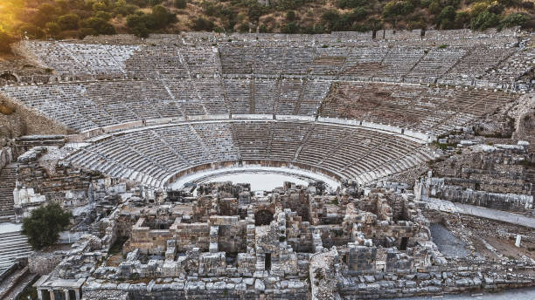
Points to Cover…
The series so far…
Thyatira - the city and its church: geography, history, culture
What does Jesus reveal about Himself?
What does Jesus commend and promise?
The significance of the ‘Jezebel’ metaphor and the warnings
How does all this apply to us in TCF today? (Throughout)

Slide 3
Summary of the Six Churches Covered…
Ephesus: Doing well in many ways but having lost its first love – so missing the point! “All Martha; no Mary”.
Smyrna: Suffering under intense persecution but passing the test with flying colours! Well done!
Pergamum: Suffering under intense persecution and most remaining faithful – but some were falling to false teaching and sexual immorality.

Slide 4
Summary of the Six Churches Covered…
Sardis: Complacent and spiritually asleep. Resting on its previous reputation. Unaware of enemy attack.
Philadelphia: Suffering faithfully under persecution from local Jews. But an open door to preach the gospel. Small, but eternally secure in Christ.
Laodicea: Totally self-sufficient, rather than trusting in Christ. ‘Lukewarm’ in attitude. Living in luxury.

Slide 5
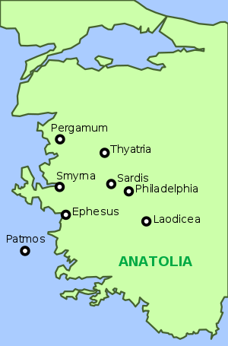
Geography of the Seven Churches…
Ephesus (now a monument)
Smyrna (now Izmir)
Pergamum (no longer exists)
Thyatira (now Akhisar)
Sardis (no longer exists)
Philadelphia (now Alasehir)
Laodicea (now Denizli)
See also Island of Patmos

Slide 6
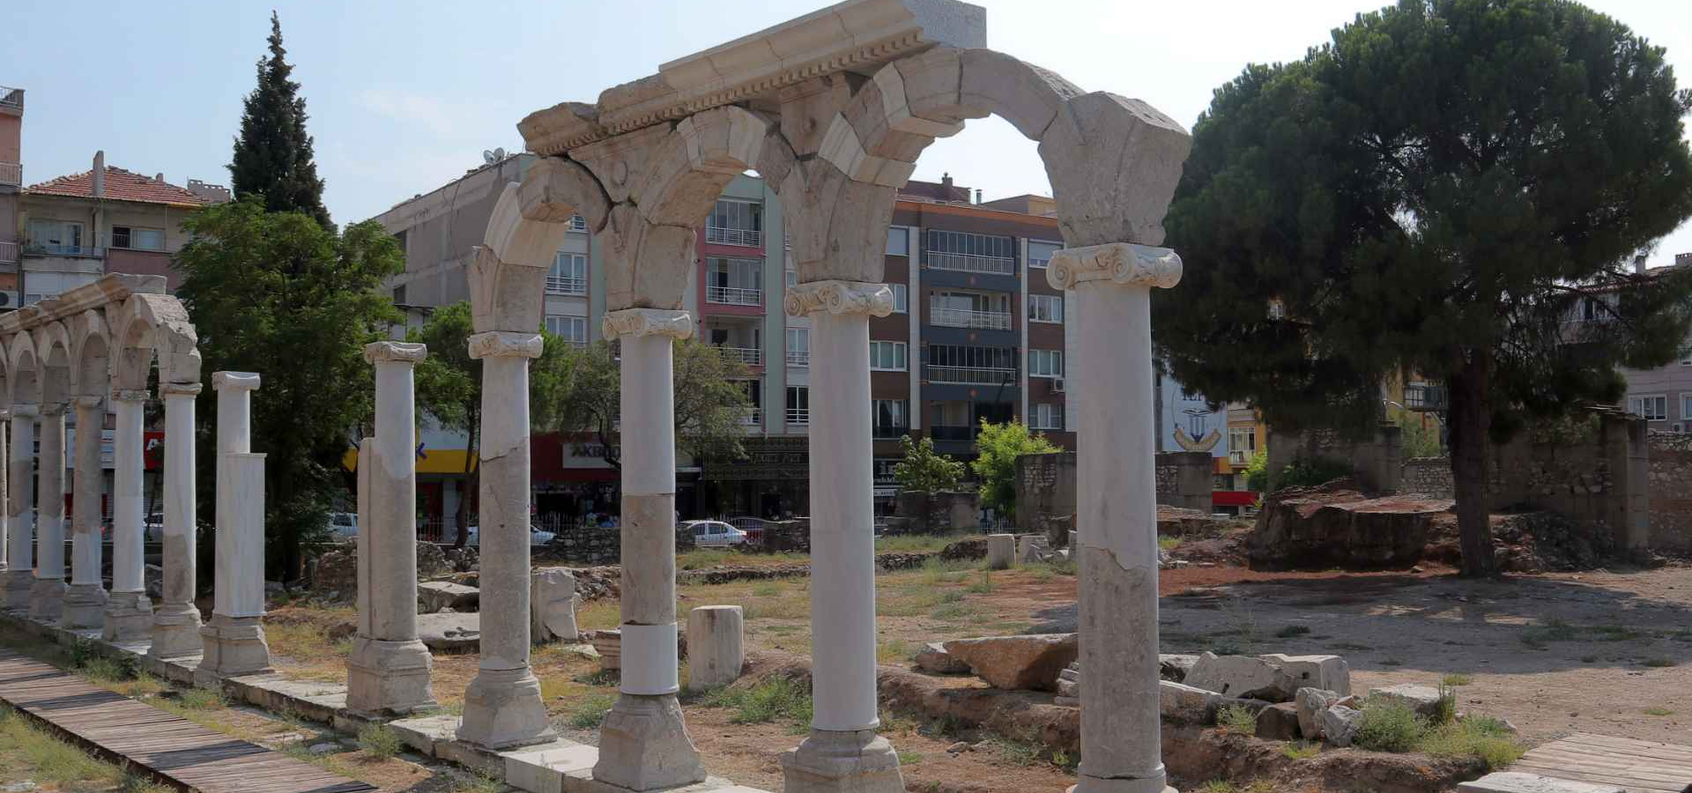
The Ancient City of Thyatira (now Akhisar)…
Notes:
This city was a communications centre, based in a valley connecting with two other valleys. It lacked natural fortifications and was wide open to attack.
In Roman times it became a trading city, known particularly for its textile and dyeing industries which produced high quality purple cloth that was only permitted to be worn by the highest-ranking Roman citizens. In the Greek city of Philippi, the Apostle Paul had met a woman called Lydia, who was a trader in purple cloth, and who came from the city of Thyatira. (Acts 16:14-15).
The citizens of Thyatira organised themselves into masonic trade guilds, such as wool workers, linen workers, tanners, potters, bakers, slave traders, etc. Each guild had its guardian god, in addition to the city god Apollo, and members of the guild were expected to worship this god and take part in feasts where the food that was brought as an offering was then eaten by the worshipper from the sacred table. The second part of the feast descended into sexual deviancy and debauchery of course. If you wanted to make a success of your trade, then you had to belong to your trade guild. And if you belonged to your guild, you had to participate fully in all its festivals!

Slide 7
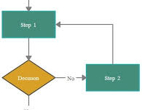
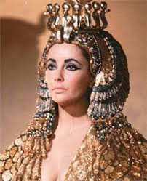
The Church At Thyatira…
A Big Dilemma! Decision Time!
Jezebel has the solution!
Notes:
[after 1]: Christians in the church at Thyatira have a dilemma: Leave their trade guild and lose both their income and their status in society – and attract persecution and ridicule instead? Or Attend those pagan feasts, eat food offered to idols and commit ritual sexual immorality?
[after 2]: Onto the scene comes the ‘prophetess’ Jezebel! Now, Jezebel was not a common Greek / Roman name. So, it is almost certainly a nickname, given to her by Jesus himself, to characterise her evil behaviour. She was a fake – a false prophet – using prophecy as a way of introducing heresy into this young persecuted church. Her solution was that, in order to defeat Satan, you must first know him, and become well acquainted with his evil methods. Clearly his ‘deep secrets’ were to be found in these sacred guild feasts, in the eating of the food of idolatry, and in coupling with the temple prostitutes who had been made available. Perhaps they were encouraged to practise on Jezebel too?
That is what she persuaded some of the church members to do; declaring prophetically that there was no need for any shame, because they were learning about the enemy, and so becoming better Christians and serving Christ well. (Conveniently, their careers did not have to suffer either!). Do we in Thurrock Christian Fellowship have any difficult dilemmas that are wide open for sinful and simplistic solutions? Watch out! Trusting God is often harder to do - but trust we must.
What did Jesus have to say about the Thyatira church and this behaviour? Let’s find out shortly! But first, let’s wind back to the beginning of this passage…

Slide 8
Revelation Chapter 2:18-29
To the angel of the church in Thyatira write: These are the words of the Son of God, whose eyes are like blazing fire and whose feet are like burnished bronze.
1 Thessalonians 4:3-7 NIV. It is God's will that you should be sanctified: that you should avoid sexual immorality; ⁴ that each of you should learn to control your own body in a way that is holy and honourable, ⁵ not in passionate lust like the pagans, who do not know God; ⁶ and that in this matter no one should wrong or take advantage of a brother or sister. The Lord will punish all those who commit such sins, as we told you and warned you before. ⁷ For God did not call us to be impure, but to live a holy life.
Notes:
[after 1]: Jesus, the Son of God, had eyes like blazing fire: all-seeing, and all-knowing. Nothing is hidden from him, including the motives of the heart
Revelation 1:15 adds that Jesus’ feet were like bronze glowing in a furnace.
Bronze was a strong metal that was a major part of the tabernacle and the temple: symbolising justice, judgement, suffering, and punishment. E.g., the Bronze Altar. At the Judgment Seat of Christ there will be the punishment to pay for ungodly behaviour – unless you have been saved. Even in the present age, like a good father, God punishes those of his children who wilfully step out of line and rebelliously disobey him. It’s for our own good. Jesus is ‘appraising’ and refining his Church, his Bride!
[after 2]: 1 Thessalonians 4:3-7 NIV. Paul is talking to Christian believers here. Those preachers who claim that Christians are unpunishable are actually incorrect. But it does not mean that we lose our salvation however.

Slide 9
Revelation Chapter 2:18-29
¹⁹ I know your deeds, your love and faith, your service and perseverance, and that you are now doing more than you did at first.
1 Peter 1:6-7. In all this you greatly rejoice, though now for a little while you may have had to suffer grief in all kinds of trials. ⁷ These have come so that the proven genuineness of your faith - of greater worth than gold, which perishes even though refined by fire - may result in praise, glory and honour when Jesus Christ is revealed.
Notes:
[after 1]: However, at Thyatira, Jesus knows that most of the members of His church are faithful and loving, their deeds reflect their heart attitudes, and they are standing firm under the persecution and hardship that comes from abandoning the pagan trade guilds. This hardship is refining and sharpening them in their faith, meaning that they are accomplishing more than they did when first saved.
[after 2]: Jesus is saying a big ‘WELL DONE’ to most of the church. The had put their careers on the line, along with their reputation and their living standards. But perseverance in a time of hardship is something that enhances our faith. This time the metal in question is GOLD! The Lord treasures our faith more than gold; nothing moves God more than our faith and our trust in him.

Slide 10
Revelation Chapter 2:18-29
²⁰ (ESV) But I have this against you, that you tolerate that woman Jezebel, who calls herself a prophetess and is teaching and seducing my servants to practice sexual immorality and to eat food sacrificed to idols.
1 Thessalonians 5:19-22 NIV. Do not quench the Spirit. ²⁰ Do not treat prophecies with contempt ²¹ but test them all; hold on to what is good, ²² reject every kind of evil.
Acts 17:11 NIV. Now the Berean Jews were of more noble character than those in Thessalonica, for they received the message with great eagerness and examined the Scriptures every day to see if what Paul said was true.
Notes:
[after 1]: False prophecy is deadly if it is not identified and uprooted. It is one of the most effective ways of introducing heresy into God’s church. The status of ‘prophet’ is usually revered, and the fakeness of the prophecies are not easily detected. We are rightly anxious not to ‘quench the Spirit’ or to ‘treat prophecies with contempt’, so sometimes, in a spirit of naive tolerance and misplaced encouragement we can accidentally let the darkness in!
[after 2]: But false doctrines are like counterfeit banknotes – sometimes hard to distinguish from the real ones. Therefore, we are also commanded to test both the prophets and their prophecies. We do this by the Holy Spirit and by holy scripture. We do not expect every prophecy to be completely balanced doctrinally, but we should expect it to align with biblical doctrines. We should expect confirmation in our spirits from the Holy Spirit too.
In Matthew 7:15-16, Jesus warns us to test the prophet as well as the prophecy: “Watch out for false prophets. They come to you in sheep’s clothing, but inwardly they are ferocious wolves. ¹⁶ By their fruit you will recognize them.

Slide 11
Revelation Chapter 2:18-29
²¹ I have given her time to repent of her immorality, but she is unwilling. ²² So I will cast her on a bed of suffering, and I will make those who commit adultery with her suffer intensely, unless they repent of her ways. ²³ I will strike her children dead.
Then all the churches will know that I am he who searches hearts and minds, and I will repay each of you according to your deeds.
²⁴ … do not hold to her teaching and have not learned Satan's so-called deep secrets…
Notes:
[after last]: We see then, that this woman, nicknamed Jezebel, was leading a sizeable number of church members astray. She had seduced them into diving into the depth of sins – supposedly so that they could learn Satan’s secrets and overthrow him – and they were particularly encouraged to take part in idolatry and to indulge in sexual immorality. “Those who commit adultery with her…” could be taken literally, or it could mean that she and they all took part in the ritual prostitution of the trade guilds; but it might carry the additional meaning that giving houseroom to an idol is committing adultery in a spiritual sense.
Jesus is not happy! He will judge them and demonstrate that He sees all, he knows all, and that the Judge of All The Earth will do the right thing. The suffering will include physical sickness and death. “Her children…” could mean the offspring of her affairs, or it could mean her spiritual disciples – or both! Just as in the example of Ananias and Saphira – who were certainly saved – being a believer in rebellion doesn’t necessarily exempt you from punishment; but not eternal punishment.

Slide 12
The Woman Jezebel in the Old Testament…
1 Kings 16:30-32 NIV. ³⁰ Ahab son of Omri did more evil in the eyes of the LORD than any of those before him. ³¹ He not only considered it trivial to commit the sins of Jeroboam son of Nebat, but he also married Jezebel daughter of Ethbaal king of the Sidonians, and began to serve Baal and worship him. ³² He set up an altar for Baal in the temple of Baal that he built in Samaria.
1 Kings 18:4 NIV While Jezebel was killing off the LORD's prophets…
1 Kings 19:2 NIV So Jezebel sent a messenger to Elijah to say, "May the gods deal with me, be it ever so severely, if by this time tomorrow I do not make your life like that of one of them."
Notes:
This prophetess in Thyatira was named ‘Jezebel’ by the Lord Jesus, due to her exhibiting the same spirit and character of her namesake ‘Jezebel’ in the Old Testament. Let’s look at a few extracts from the Book of 1 Kings that sum up Jezebel’s life on earth…
[after 1]: The name “Jezebel” can mean un-husbanded or chaste.
King Ahab of the Northern Kingdom of Israel unwisely married Jezebel, the daughter of the king of the Sidonians, in the region of Phoenicia (now modern-day Lebanon). Her father was a pagan ruler who was a devotee of the worship of Asherah, the female goddess also known as Astarte or Ishtar, and the mythical mother of Baal. Jezebel lost no time in importing this particular style of Baal worship to Israel and was obviously delighted that her infatuated husband allowed her to legitimise idolatrous practices alongside some token worship of the Lord. Idol-worship is at its most sinister when it is combined with the true faith, since it seems to get approval by the majority. Later, Jezebel persuaded Ahab to create a ‘black magic’ version of Jerusalem’s temple in Samaria, by constructing a temple to Baal; he also erected an Asherah pole – effectively a huge phallic symbol targeted at the female goddess, Asherah alongside it. This kind of pagan worship was crude, perverted, and ugly.
[after last]: A few years later, Jezebel used her influence to systematically murder most of the genuine prophets of the Lord in Israel. And after Elijah’s triumph over the prophets of Baal at Mt Carmel, she vowed to eliminate Elijah too.

Slide 13
The Woman Jezebel in the Old Testament…
1 Kings 21:6-10 NIV He answered her, "Because I said to Naboth the Jezreelite, 'Sell me your vineyard; or if you prefer, I will give you another vineyard in its place.' But he said, 'I will not give you my vineyard.’” ⁷ Jezebel his wife said, "Is this how you act as king over Israel? Get up and eat! Cheer up. I'll get you the vineyard of Naboth the Jezreelite." ⁸ So she wrote letters in Ahab's name, placed his seal on them, and sent them to the elders and nobles who lived in Naboth's city with him. ⁹ In those letters she wrote: "Proclaim a day of fasting and seat Naboth in a prominent place among the people. ¹⁰ But seat two scoundrels opposite him and have them bring charges that he has cursed both God and the king. Then take him out and stone him to death."
Notes:
[after last]: We see in the narrative above that she would usurp King Ahab’s authority without a second thought, in order to get her way. Jezebel was controlling and coercive. She always got her own way. She was almost certainly demonised with a very powerful spirit of darkness, probably inherited from her pagan father.

Slide 14
The Woman Jezebel in the Old Testament…
2 Kings 9:22 NIV When Joram saw Jehu he asked, "Have you come in peace, Jehu?" "How can there be peace," Jehu replied, "as long as all the idolatry and witchcraft of your mother Jezebel abound?"
2 Kings 9:30-33 NIV Then Jehu went to Jezreel. When Jezebel heard about it, she put on eye makeup, arranged her hair and looked out of a window. ³¹ As Jehu entered the gate, she asked, "Have you come in peace, you Zimri, you murderer of your master?" ³² He looked up at the window and called out, "Who is on my side? Who?" Two or three eunuchs looked down at him. ³³ "Throw her down!" Jehu said. So they threw her down, and some of her blood spattered the wall and the horses as they trampled her underfoot.
Notes:
[after 1]: Jezebel doubled down on her passions for idolatry and witchcraft. After her husband Ahab’s death she turned her manipulative skills towards her son, King Joram.
[after last]: Jehu, God’s next chosen king for Israel, was the first man really prepared to stand up to her, and he boldly attacked her stronghold. Even then, she turned up the manipulation and seduction, using her stunning beauty and physical attractiveness to try to convince Jehu to spare her life. However, it didn’t work this time!

Slide 15
The Jezebel Spirit: Then and Now…
Jezebel died, but her demonic spirit lived on
The woman at Thyatira could well have been similarly demonised – giving her the same personal qualities…
A worshipper of false gods / idols / witchcraft
Aiming to silence the true prophets of God
Coercive and controlling; usurping godly authority
Sexually manipulative, promiscuous, depraved
Religious – ‘fits in’ to some extent, but heretical.
Notes:
[after 1]: A demonic spirit infects the bodies and lives of all the people it inhabits – female and male. It produces the above characteristics of Jezebel. It is a very powerful adversary.
In 2 Kings 11, we see exactly the same attitudes and behaviour in Athaliah, the daughter of Ahab and Jezebel, who married the King of Judah, Jehoram. After Jezebel had been killed, Athaliah took over the throne of Judah and ruled as a tyrant for six years, until she was deposed by the boy king, Joash. So we clearly see the spirit of Jezebel in full operation in Athaliah’s life. It probably came down as a generational curse. The whole story is found in 2 Kings chapters 8 to 11.
[after 2]: There is no indication that the Jezebel spirit has disappeared today, so we must be on our guard for it to appear in any situation. Particularly when there is about to be a genuine move of God – as we are expecting and praying for. Let’s be watchful and alert; the devil has many schemes. Look at the five main characteristics of the Jezebel spirit in our day.
[after last]: However, the spirit of Jehu overcame the historical Jezebel, and that is what the Lord is giving us too. We overcome everything by the Blood of the Lamb and the Word of our Testimony. There is nothing to fear!

Slide 16
Revelation Chapter 2:18-29
Now I say to the rest of you in Thyatira…
'I will not impose any other burden on you, ²⁵ except to hold on to what you have until I come.’ ²⁶ To the one who is victorious and does my will to the end, I will give authority over the nations - ²⁷ that one 'will rule them with an iron sceptre and will dash them to pieces like pottery' -just as I have received authority from my Father. ²⁸ I will also give that one the morning star. ²⁹ Whoever has ears, let them hear what the Spirit says to the churches.
Notes:
[after last]: We need to hold on to the truth, to our vision and prophetic words, to Jesus himself. But we can do much more than that – given that we are not under the level of persecution that Thyatira was experiencing. The boldness of Jehu in taking ground in spiritual warfare is what the Holy Spirit is calling us to. Warfare, prayer, intercession, tongues, declaration.
Ruling with a rod of iron and dashing the nations to pieces like pottery is another example of authority and judgement. This is a quote from Psalm 2, concerning the Messiah, and the symbolism on that of the master potter who assesses his work and breaks all those pots that fail to come up to his normal standards – so that are not accidently sold and tarnish his reputation. We will be given the authority to judge the nations, sitting on thrones by Jesus’ side.
Micah 4:13 NIV
“Rise and thresh, Daughter Zion, for I will give you horns of iron; I will give you hooves of bronze, and you will break to pieces many nations.” You will devote their ill-gotten gains to the LORD, their wealth to the Lord of all the earth.
The morning star in Revelation 22:16 is Jesus himself. He will us Himself to know and to love for ever. Are we prepared to devote ourselves to Him and promote his Kingdom?

Slide 17
Words For Thurrock Christian Fellowship…
2 Kings 6:16 NIV. "Don't be afraid," the prophet answered. "Those who are with us are more than those who are with them."
1 John 4:4 ESV. Little children, you are from God and have overcome them, for He who is in you is greater than he who is in the world.
Luke 10:18-19 NET. So Jesus said to them, "I saw Satan fall like lightning from heaven. ¹⁹ Look, I have given you authority to tread on snakes and scorpions and on the full force of the enemy, and nothing will hurt you.
Notes:
[after last]: We are more powerful in Christ than all the forces of darkness that might attack us. So we do not need to be afraid. However, we do need to demonstrate the spirit of Jehu who went on the attack against those spiritual forces and overcame them. We HAVE the authority! Let’s use it! By prayer, intercession, declaration of the Word of God, speaking aloud the gospel… We wage warfare. Rise up TCF!

